Slide 1


Cybersecurity initiatives at the University of Ottawa
November 28 2022
Notes:
JB
Welcome from Dean
Thank you for joining us today.

Slide 2

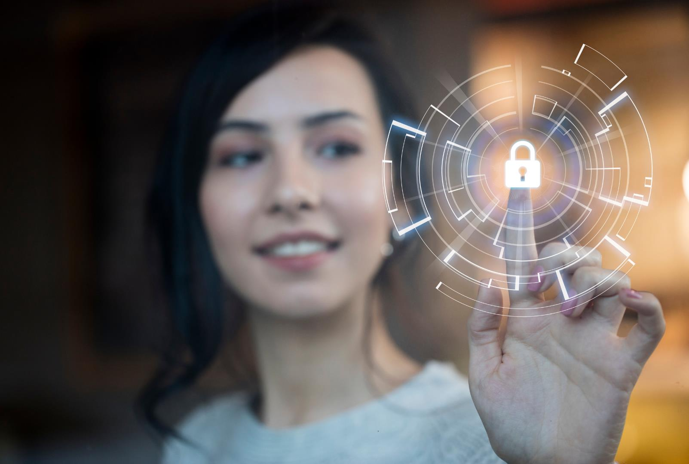
uOttawa is making cybersecurity and cybersafety a priority
We are tackling the growing threat of cyber
attacks and cyber crime head on.
Notes:
SYLVAIN
Cybersecurity - what it means for uOttawa
There is an urgent need for innovative technology, new legal frameworks, effective organizational responses, and training strategies to get ahead of the threats.

Slide 3

The Cyber Hub is designed to be:
Inclusive
Interdisciplinary
Integrated
Immersive
Innovative
Brings together world-class researchers, experts and leaders to drive excellence
in experiential training and interdisciplinary research in cybersecurity and cybersafety.
Notes:
SYLVAIN
Present the Cyber Hub (brief overview)
The University of Ottawa is building a cyber security hub on the 5th floor of our state-of-the-art STEM building that will bring together more than 40 of the University’s top academics from several faculties, including engineering, law, and business.
The goal is to keep governments, organizations, and individuals one step ahead of cyber threats by funding research, developing the cyber security workforce of the future, and building critical infrastructure to support training.
The hub will make cyberspace safer by driving the kind of research, training, and national expertise that can counter emerging threats and relieve the acute shortage of cybersecurity personnel in both the public and private sectors.

Slide 4
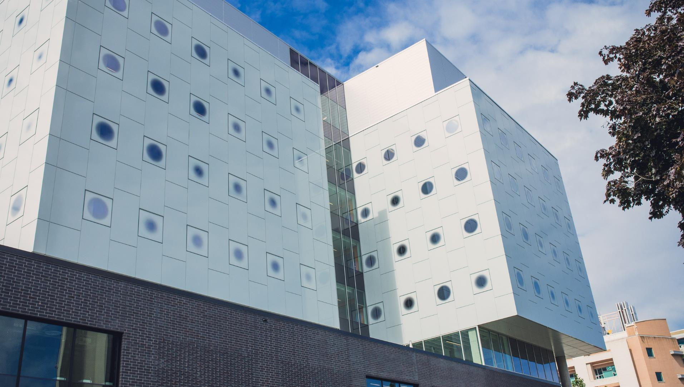
At the Faculty of Engineering
Over 6500 students
2500
2000
3500
undergraduate
Canadian
students enrolled in our School of Electrical Engineering and Computer Science programs
1000
1500
graduate
international
And over 130 full-time professors
Notes:
JB
What we have to offer is: Expertise + Talent.
We currently have approximately 7,000 students in the Faculty of Engineering and over 130 full-time professors.
Half of these numbers are in the IT sector.
3500 of our students are enrolled in our Electrical Engineering and Computer Science programs.
Nearly 1500 of those are International students and 2000 are Canadian.
CLICK
Introduce Sylvain Charbonneau,
Vice-President, Research and Innovation, uOttawa

Slide 5
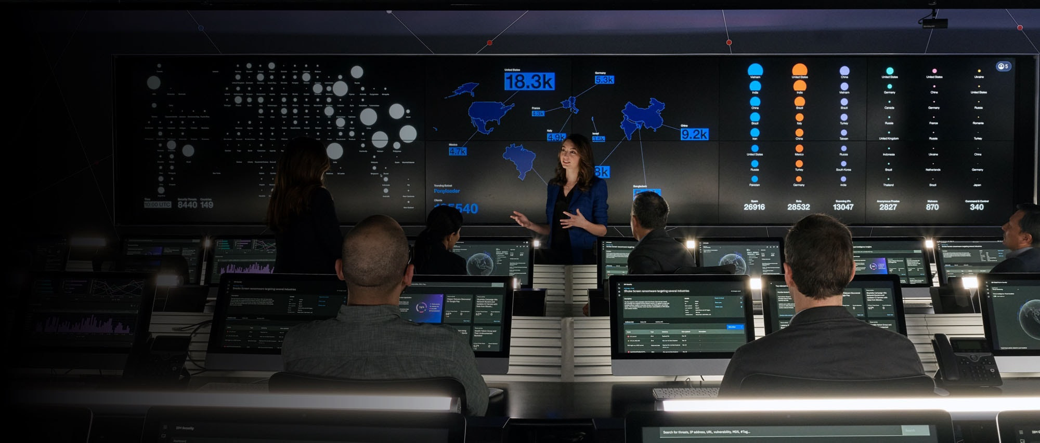
The uOttawa-IBM Cyber Range
Enabling learning, training, research, and outreach
Notes:
GUY-VINCENT
The Cyber Range will enable:
- learning,
- training,
- research,
- and outreach
It will provide a wide range of applications and services to support evolving cybersecurity needs.
It will enable students, experts, researchers, and entrepreneurs to conduct training exercises, test products, undertake cybersecurity research, and hone their skills against real-world cybersecurity attacks, all in safe, emulated digital environment.

Slide 6
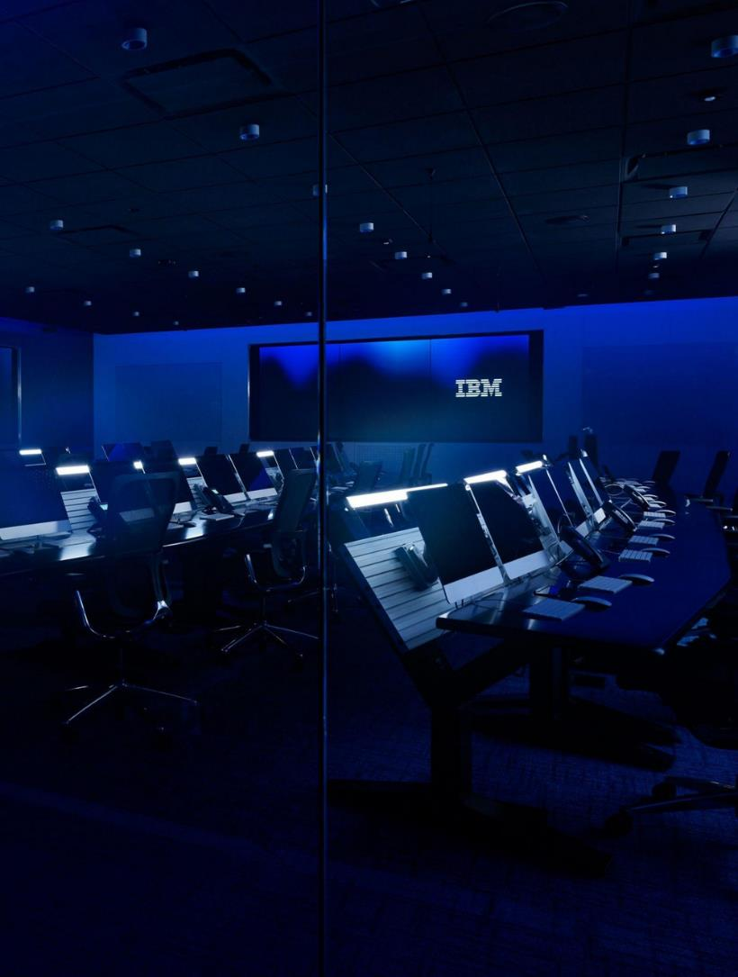
About the Cyber Range
Located in the Cyber Hub, the Cyber Range, created in partnership with IBM, will deliver security training, professional development, and partnering opportunities in both official languages to help grow Canada’s skilled cybersecurity and cybersafety workforce across government, academia and industry.
Our Cyber Range directors
Guy-Vincent Jourdan
Vio Onut
Professor
Faculty of Engineering
University of Ottawa
Principal R&D Strategist
Centre for Advanced Studies IBM
Notes:
GUY-VINCENT
The Cyber Range within uOttawa’s Cyber Hub will provide significant training and interdisciplinary research capabilities for students, businesses and government organizations.
It’s also a critical piece of infrastructure that will help address the country’s current cybersecurity talent gap, from full-time students to professionals already in the workforce.

Slide 7
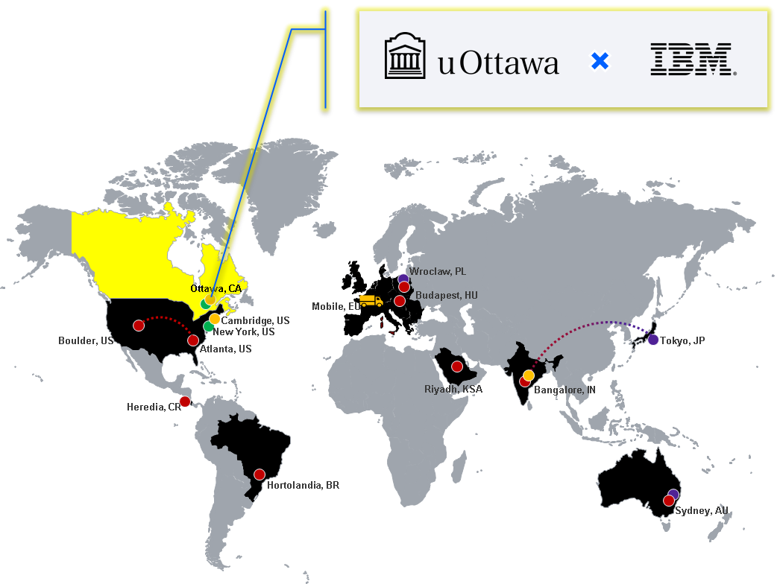
Security Operations
12 Global and Regional SOCs (Managing Clients SOC operations) monitoring 4.7 trillion events per month from 20,000-plus devices
Entrusted by Clients for tactical Security Incident Response
50 years in security business
About IBM Security
Leveraging IBM extended Security & Higher Education teams as needed
Training
Our Cyber Ranges train 10,500+ clients
industry's first cyber range for commercial, government, healthcare and academia
a first-of-its-kind training, simulation and security operations center on wheels
Research
Threat Prevention, Detection & Investigation
Threat Response and Recovery
Security Technology Management & Monitoring

Slide 8

https://youtu.be/WC6ABBhupYw
Notes:
In case video doesn’t play, click here or on bottom middle of screen: https://youtu.be/WC6ABBhupYw

Slide 9
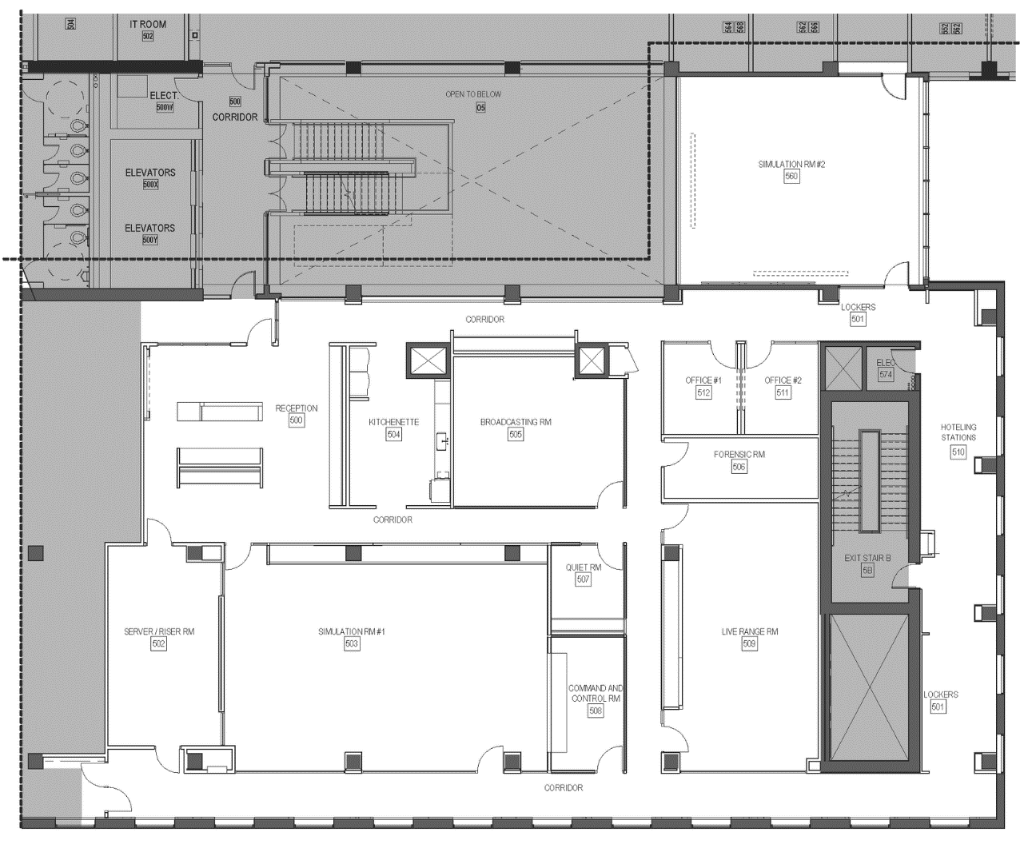
Floor
Plan
Notes:
JB
This is the current floor plan which you will have the chance to visit in just a few minutes.
CLICK
Introduce Guy-Vincent Jourdan
Professor at the Faculty of Engineering and Co-Director of the Range

Slide 10
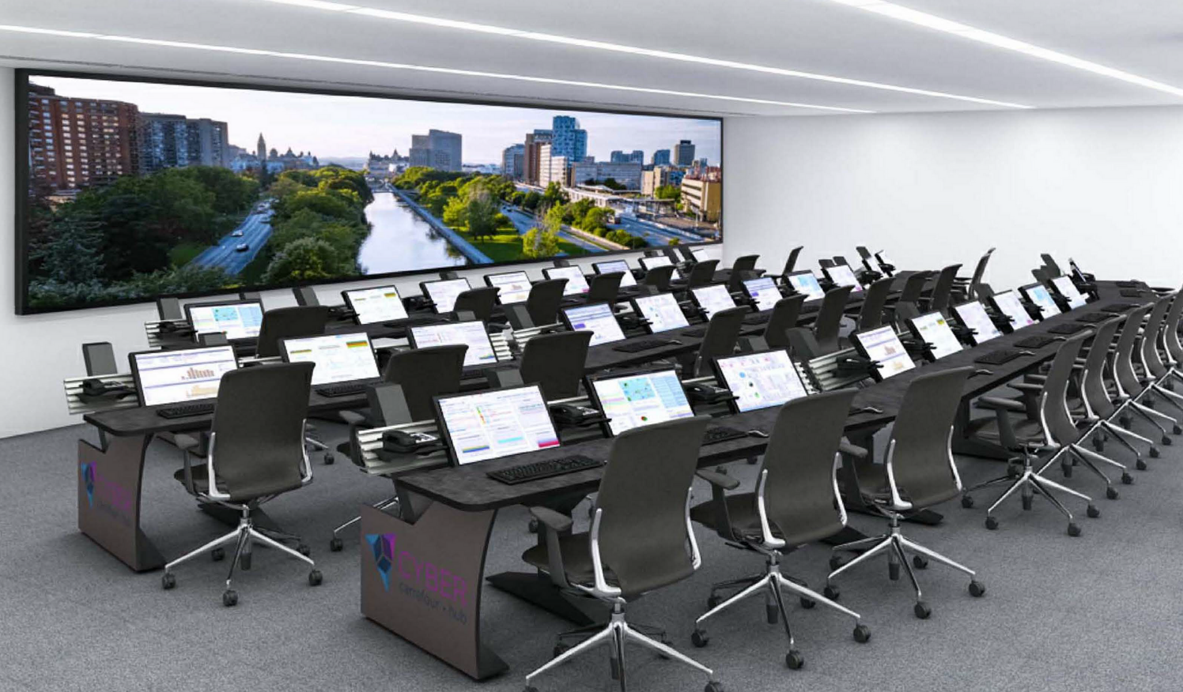
Rendering of Main Cyber Range Room
Notes:
GUY-VINCENT
Rendering of simulation room 1
Main room

Slide 11
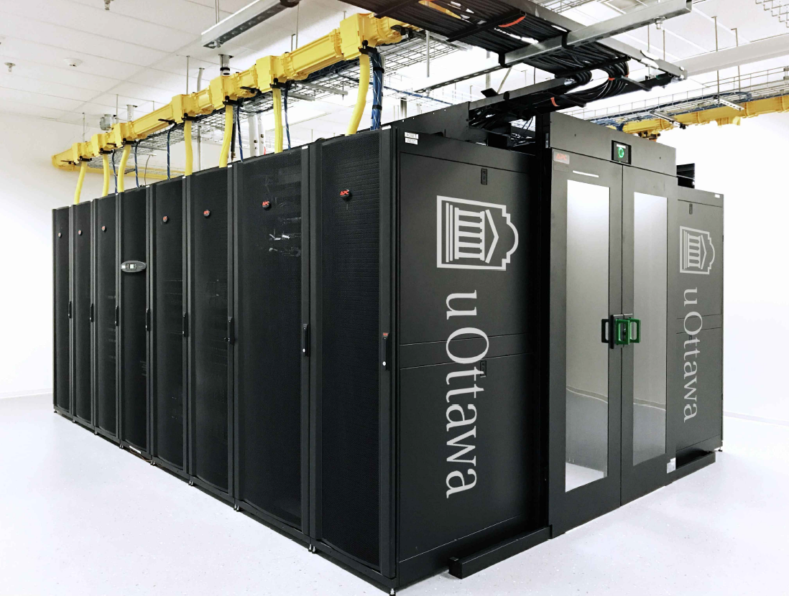
Server
Room
Notes:
GUY-VINCENT
Server room
(what it's for, the security around it)

Slide 12






The Cyber Range is multi-year partnership with IBM to create a fully immersive, interactive, and experiential learning facility for research and training in cybersecurity for students, businesses, and government organizations.
Immersive
Learning
Tailored
Training
Interdisciplinary Research
Community
Building
Powered by state-of-the-art technology, integrated within our curriculum and in partnership with companies and government.
Real-world scenarios, advanced simulations and an immersive delivery experience.
Into new areas of threat defence, analytics, AI security, cyber law, and organizational response.
Create the next generation of experts by engaging with youth, uniting the cyber community and by attracting a diverse talent pool.
Notes:
GUY-VINCENT
(if Sylvain did not talk about the IBM agreement and benefits of working with them, do so here).
List off the 4 main activities / purpose of the range

Slide 13



ACADEMIC PROGRAMS
Cyber Range training will be integrated into undergraduate and graduate courses, and within microprograms.
Immersive Learning
PROFESSIONAL SKILLS DEVELOPMENT
New microprograms and micro-credentials are open to professionals, with flexible delivery and adapted schedule.
INDUSTRY CERTIFICATION
Cyber Range training will be coupled with industry certifications (NSE, IBM, CompTIA, and more).
Notes:
GUY-VINCENT
Immersive Learning
All types of training levels for students.
Integrated into the curriculum through undergraduate 4th year courses, microprograms and key graduate courses.
Industry Certification promoted to our student population (NSE, IBM, CompTIA, and more)

Slide 14



A unique cybersecurity training and testing facility that provides experiential learning opportunities that are both immersive and ultra-realistic.
TRAINING PLATFORM
Tailored Training
Access the Cyber Range to upskill or reskill your team, and validate technical skills using our wide array of cybersecurity scenarios.
CYBERSECURITY RESPONSE
Immerse your technical and leadership teams in an engaging session to hone your cybersecurity response.
CUSTOMIZABLE ENVIRONMENT
Build an interactive emulation of your local network, systems, tools, and applications using the CITEF™
Notes:
GUY-VINCENT
For companies
We also offer this service to external clients.
Developed in collaboration with the RHEA Group, and powered by their technology, our Cyber Range lets clients build an interactive emulation of their local network, systems, tools and applications using the Cyber Integration, Test and Evaluation Framework (CITEF™).
The CITEF lets clients build a blueprint of their organization’s ecosystem, and then overlay cyber attack scenarios.
TYPES OF TRAINING
Technical vs C-suite simulation (IBM type).

Slide 15
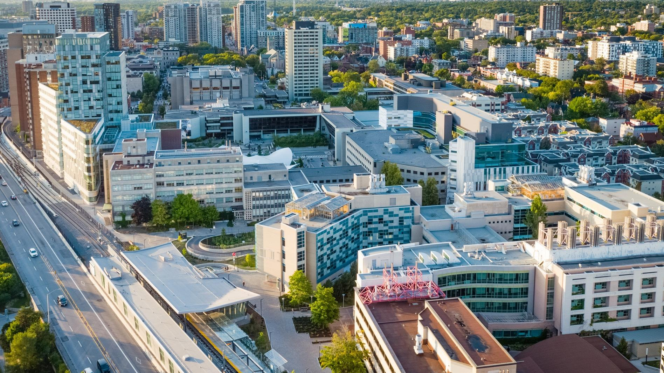
Interdisciplinary Research
Key National Cyber
Research Infrastructure
Notes:
GUY-VINCENT
This Cyber Range is a Key National Cyber Research Infrastructure.
uOttawa Engineering's interdisciplinary cybersecurity experts are leaders in developing solutions for a wide range of wired and wireless communication networks to protect the integrity of both business and personal data.
Examples of interdisciplinary research initiatives leveraging the Cyber Range include:
- the study of cyber-attack management and organizational response,
- the implementation of novel cybersecurity and cyber safety methods, policies, tools, and systems.
Eventually, no less than seven faculties will use the Cyber Range including Engineering, Law, Telfer School of Management, Social Sciences, Science, and Medicine.

Slide 16
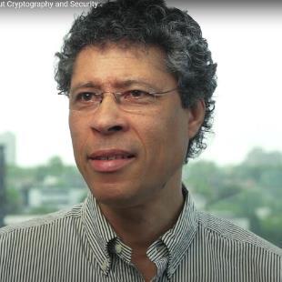
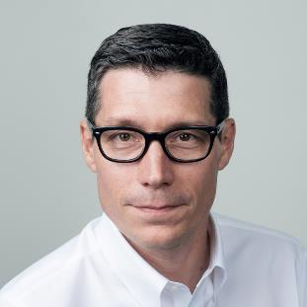
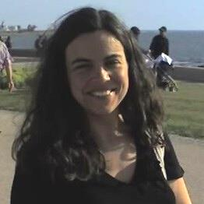
Meet our Cyber Experts
Carlisle Adams
Roland Bouffanais
Paula Branco
cadams@uOttawa.ca
Cryptography and Computer Security Research
Cryptography, network security, computer security, access control, and privacy.
rbouffan@uOttawa.ca
Secure Networked Systems
Control strategies for 5G+ networks enabling anticipated and reactive architectures and algorithms for security.
pbranco@uOttawa.ca
AI Methods to Detect Fraud, Scams,
and Intrusions
Malware detection, intrusion detection, network traffic anomaly detection, misuse and signature detection.
Notes:
GUY-VINCENT
Introduce your colleagues in this room.
Highlight the existing research expertise
Guy-Vincent Jourdan: Cryptography, Computer and Network Security, and Privacy Technologies
Paula Branco: AI Methods to Detect Fraud, Scams, or Intrusions
Lionel Briand: Canada Research Chair in Intelligent Software Dependability and Compliance (Tier 1)
Roland Bouffanais: Designing and Managing Secure Networked Systems
Paria Shirani: Cybersecurity of Firmware and IoT
Carlisle Adams: Cryptography and Computer Security Research
What we can do for Financial Institution?
Financial compliance, laundering money,

Slide 17
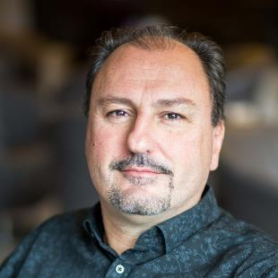
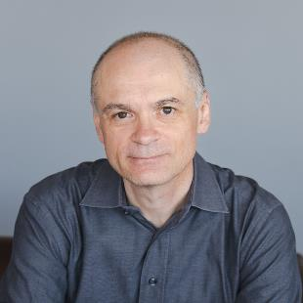
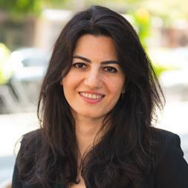
Meet our Cyber Experts
Lionel Briand
Guy-Vincent Jourdan
Paria Shirani
lbriand@uOttawa.ca
AI-Based Software Security Testing and Analysis
AI-based solutions for automated security testing and
analysis of application software.
gjourdan@uOttawa.ca
Cryptography, Computer and Network Security, and Privacy Technologies
Distributed systems modelling and analysis, software security, cybercrime detection and prevention and ordered sets.
pshirani@uOttawa.ca
Cybersecurity of Firmware and IoT
Anomaly detection, cyber-persona identification,
IoT security, malicious code, malware analysis, vulnerability detection.
Notes:
GUY-VINCENT
Introduce your colleagues in this room.
Highlight the existing research expertise
Guy-Vincent Jourdan: Cryptography, Computer and Network Security, and Privacy Technologies
Paula Branco: AI Methods to Detect Fraud, Scams, or Intrusions
Lionel Briand: Canada Research Chair in Intelligent Software Dependability and Compliance (Tier 1)
Roland Bouffanais: Designing and Managing Secure Networked Systems
Paria Shirani: Cybersecurity of Firmware and IoT
Carlisle Adams: Cryptography and Computer Security Research
What we can do for Financial Institution?
Financial compliance, laundering money,

Slide 18
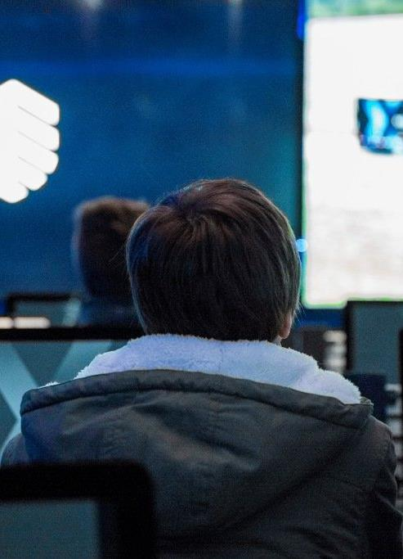
Community Building
Host events, conferences, seminars, and hackathons to bring together the cyber community.
Support youth in their journey to build cybersecurity literacy with local outreach programs for kids and teens such as workshops, summer camps, enrichment programs, demos, and more.
Build international collaborations with other educational institutions to expand the talent pool.
Support historically underrepresented students with programming, scholarships, and grants to incentivize greater diversity in this field.
Notes:
GUY-VINCENT
This space within our University will become key to raising the profile of Cyber in education and in research.
We want to make THIS the reference, the place to gather at all ages to connect with passionate and like-minded individuals. We want to host events, conference and seminars, and unite the community here in Ottawa, like we're doing today.
We will build on our existing Youth Outreach program, which is already one of the strongest in the country, and support youth in their journey to build cybersecurity literacy, all the while sparking their interest in the constantly evolving field of cybersecurity as a potential career pathway.
We want to help future generations.
And of course diversity is a vital part in our collective toolkit to guarantee more robust, more innovative and more agile ideas.
We work to improve the learning environment for underrepresented groups.
CLICK
INTRO ROB

Slide 19
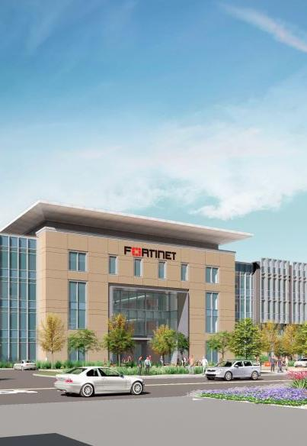
Partnership uOttawa and Fortinet
WHO IS FORTINET?
Largest pure play cybersecurity company, with over 10,000 employees globally
Headquartered in Sunnyvale, California
50+ products across 8 different solution areas
Founded in 2000
IPO 2009 ($156M > $54B) added to S&P 500 in 2018
THEIR CANADIAN PRESENCE
Primary development office in Burnaby, BC
FortiGuard Research Labs in Burnaby, BC
Largest North American Support Centre in Ottawa
Fortinet NSE Training Institute in Ottawa
Approx. 1,800 Canadian employees

Slide 20
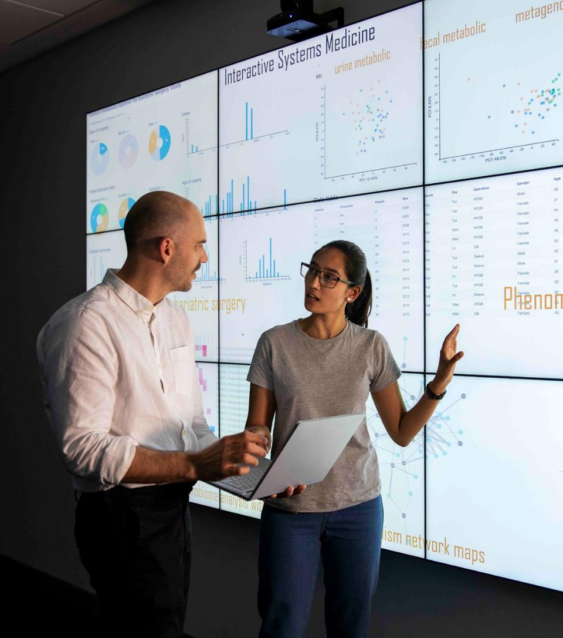
Fortinet has over 450 Partners around the globe, however they only have six Strategic Partners. uOttawa is the exclusive Canadian Strategic Partner.
Strategic Partnership
Custom training program to increase talent recruitment
Integration of Fortinet training material into uOttawa courses and micro-credential
Full access to cloud-based labs and certification vouchers for our students (NSE 4)
Certified students given paid internship opportunities
Secured a collaborative provincial grant for the development of a micro-credential course

Slide 21
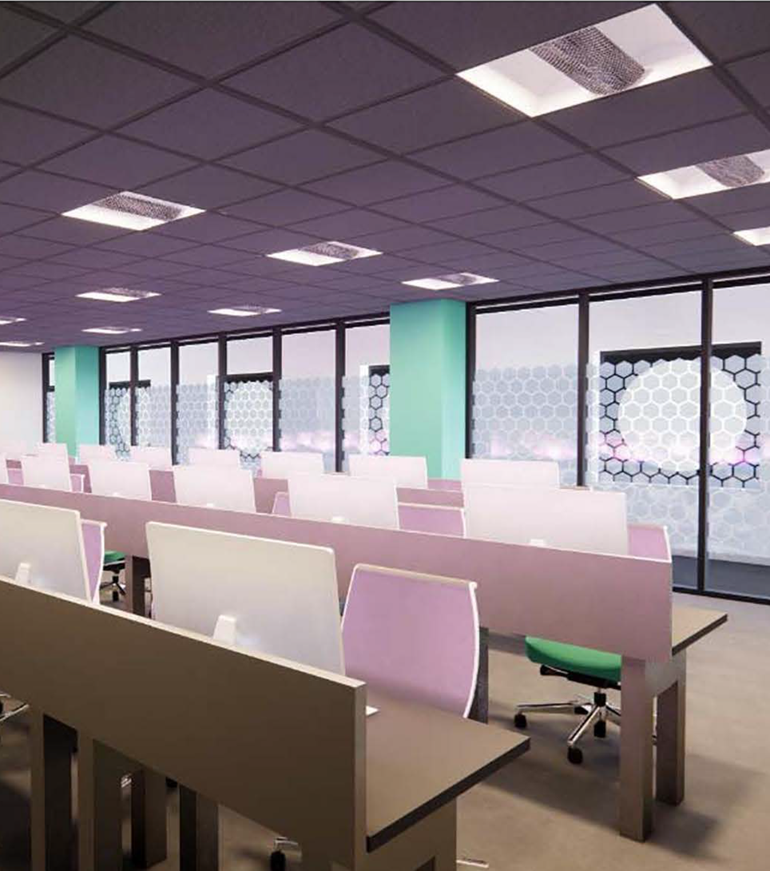
Inside the Cyber Range
Integrating Fortinet offer into the Range
Provided over $1M worth of VM and licenses to use in training and in research
Once the range goes live, Fortinet will provide hardware, allowing hands-on experience for both trainees and grad students
Working on a larger, federal grant involving Fortinet equipment supporting this state-of-the-art new facility
Notes:
ROB
Fortinet inside the Cyber Range:
• Fortinet is providing over $1M worth of VM and licenses to use in training and in research at the cyber range.
• Once the range goes live, the intent is to also provide hardware, allowing hands-on experience for both trainees and grad students researchers

Slide 22
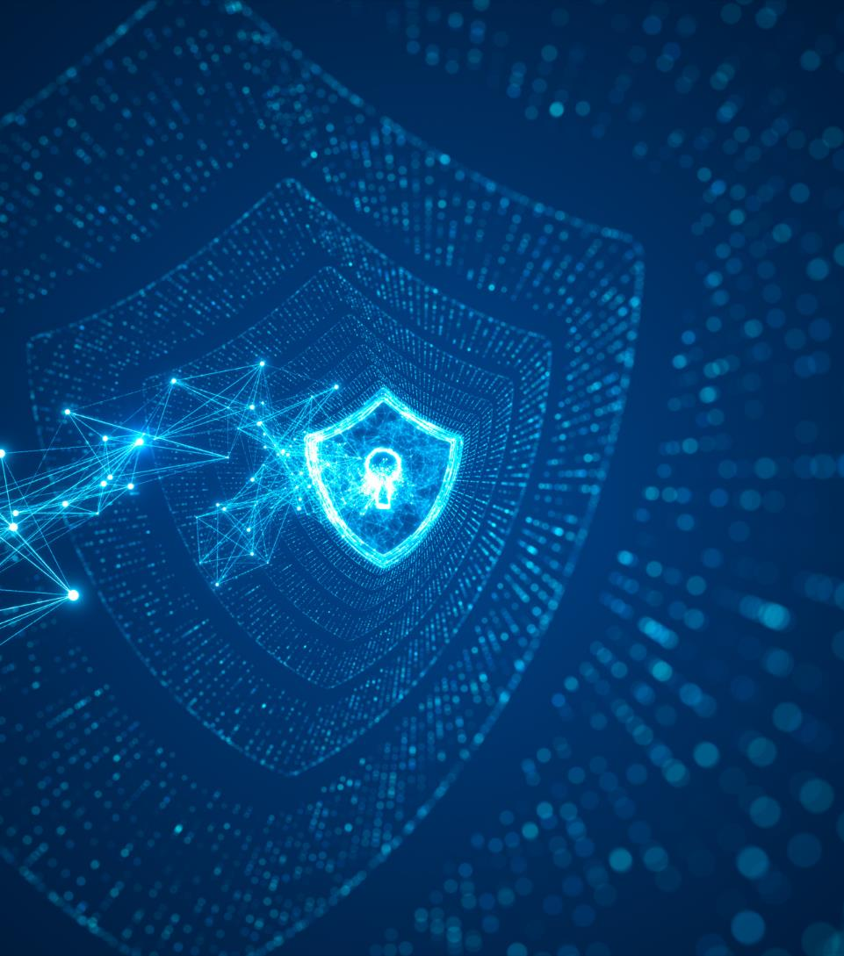
Research collaboration
Internationally trusted research and innovation
Establishing key research projects between Fortinet’s R&D department and the research teams at uOttawa Engineering, in particular around AI and cybersecurity
Fortinet is an industry partner for an infrastructure grant application for the Cyber Range research lab
Notes:
ROB
Research collaboration
• Discussions are ongoing for establishing research projects between Fortinet’s R&D department and the research teams at the range, in particular around AI and cybersecurity
• Fortinet is one of the industry partners for an infrastructure grant application (Canada Foundation for Innovation grant - CFI) for the research lab of the cyber range

Slide 23
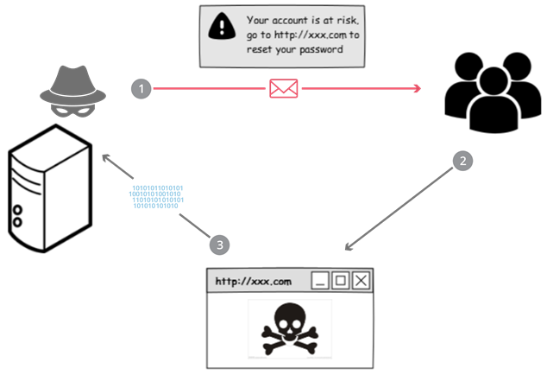
Phishing attacks
internet attack impersonating trustworthy website
Tricks end-users into providing sensitive information

Slide 24
Phishing Attack Detection and Evolution (client side)
Cui, Q., Jourdan, G.-V., Bochmann, G. v., Onut, I.V and Flood, J. Phishing Attacks Modications and Evolutions, Proceedings of ESORICS 2018, Barcelona, Spain, September 2018.
LePage, S., Cui, Q., Jourdan, G.-V., Bochmann, G. v., Flood, J., and Onut, I.V. Using AP-TED to Detect Phishing Attack Variations, proceedings of the 16th conference on Privacy, Security and Trust (PST 2018), Belfast, Ireland, August 2018
Cui, Q., Jourdan, G.-V., Bochmann, G. v., Couturier, R., and Onut, I.V. Tracking Phishing Attacks Over Time , in 26th World Wide Web Conference (WWW'17), Perth, Australia, April 2017

Slide 25
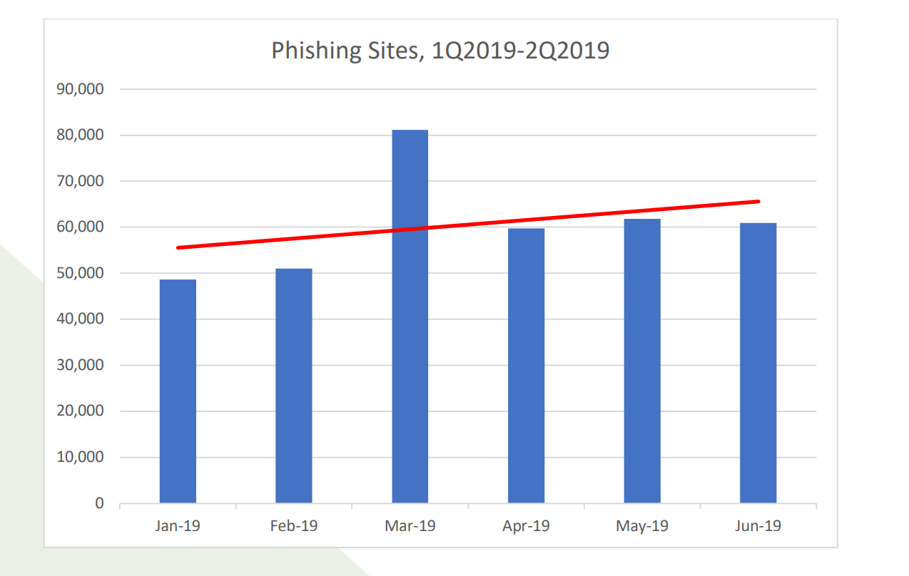
Phishing Attack Detection and Evolution (client side)
APWG 2019 Q1,Q2 report
Lifespan of an attack is very short
Attackers need to constantly renew attacks
Building from scratch not economically viable
Attacks are recycled
Duplicate detection faster

Slide 26
Phishing Attack Detection and Evolution (client side)
Extract Tag Vector
Compute Proportional Distance
Cluster Similar Attacks
Tag vector = number of times each html tag appears in the DOM
PD(t1, t2) = $\frac{Hamming Distance}{\# of tags that appear in at least one vector}$
Database:~100K attacks (PhishTank, IBM X-Force, OpenPhish)
Detection > 90%
false positive ~ 0.5%

Slide 27
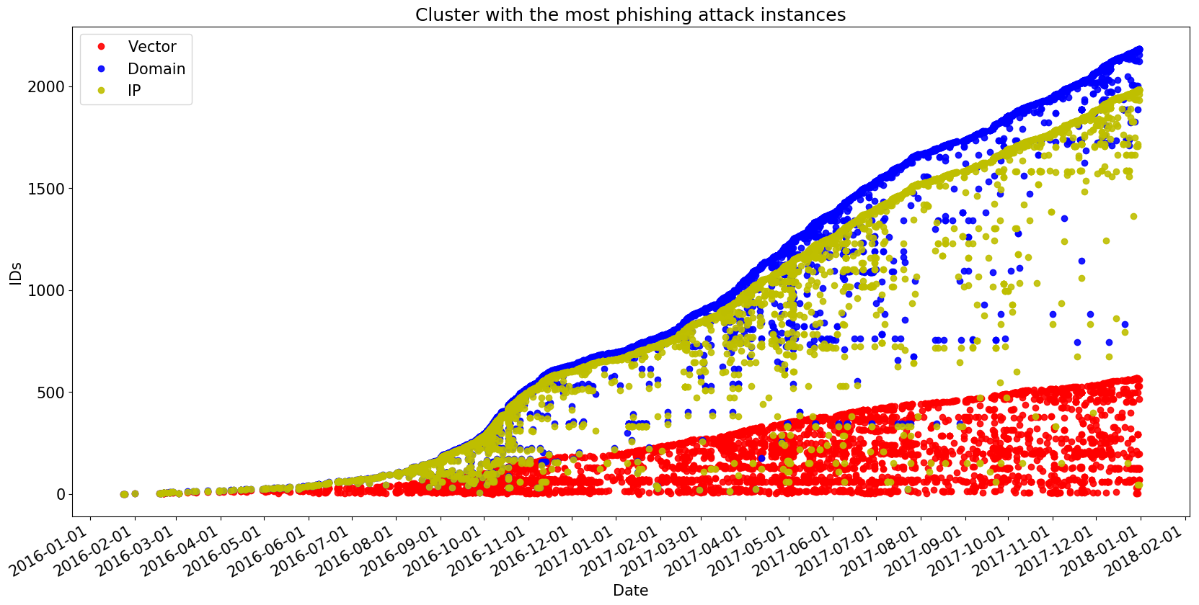
Phishing Attack Detection and Evolution (client side)
More than 40% of the clusters are active for more than within one month
Some remain live for two+ years, including more than 20% phishing instances.

Slide 28
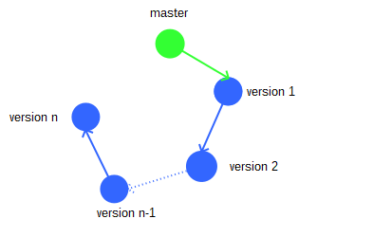
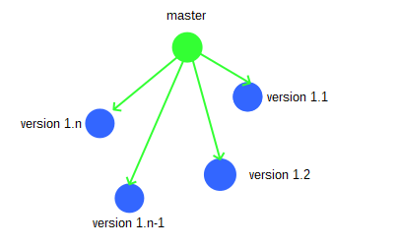


Phishing Attack Detection and Evolution (client side)
Variation History
Average length of variation path | < 2
Average update interval | 186 days

Slide 29
0-delay phishing attack detection using machine learning (server side)
Cui, Q., Jourdan, G.-V. and Onut, I.V, Proactive Detection of Phishing Kit Traffic, 19th International Conference on Applied Cryptography and Network Security, Kamakura, Japan, June 21-24, 2021

Slide 30
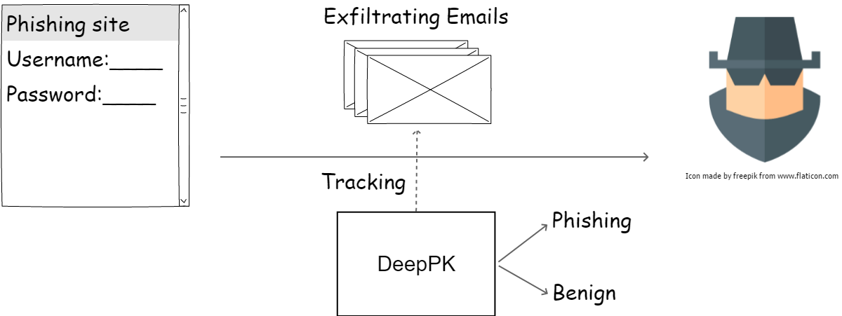
0-delay phishing attack detection using machine learning (server side)
Detection of an attack being deployed on a network
No active scan of the network
No prior report requirement
ZERO delay in detection => ZERO victim

Slide 31
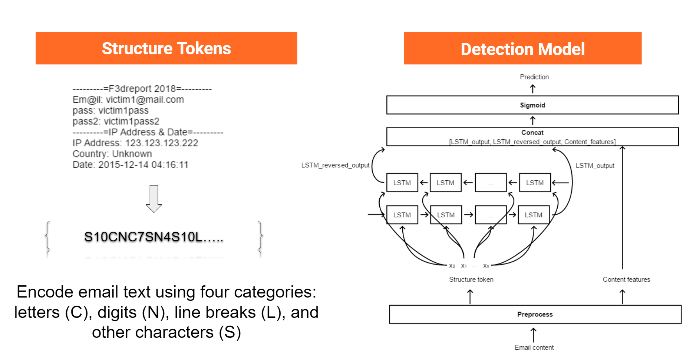
0-delay phishing attack detection using machine learning (server side)
DeepPK: Long Short-term Memory Model-based detection system

Slide 32
0-delay phishing attack detection using machine learning (server side)
2) ~370 sources of data collected by real Phishing attacks
Exfiltration database 330K+ values
1) Secure execution of 3K+ Phishing Kits
~6.5K email templates
3) Automatic generation of exfiltration emails
~65K used in the study
DeepPK:
>98% precision, >99% recall
FP ~0.3%
More resilient to a range of evasion techniques than other classifiers

Slide 33
Phishing Kits Source Code Similarity Distribution
Goal: Reconstruct a plausible “lineage” of phishing kits
Dataset: 5 475 phishing kits
~190k PHP files
~62M LOC

Slide 34
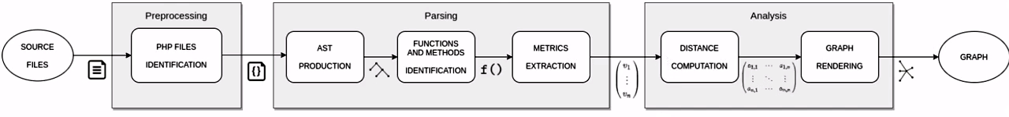
Approach
Static analysis
Similarity detection via token types and structural metrics
Fragments: functions and methods
Manhattan distance (L1) between fragments

Slide 35
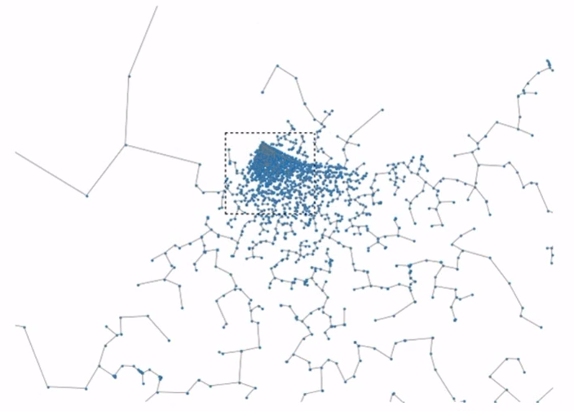
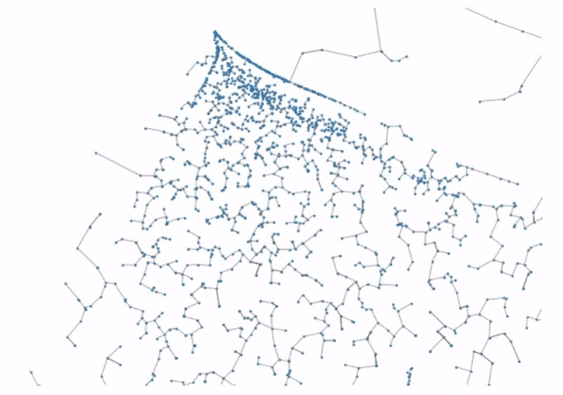
Lineage
5 475 kits
~190k PHP files
~62M LOC

Slide 36
Phishing domain name detection using word semantics
Cui, Q., Jourdan, G.-V., Bochmann, G. v. and Onut, I.V, SemanticPhish: A Semantic-based Scanning System for Early Detection of Phishing Attacks, in Proceedings of E-Crime 2020, virtual event, November 2020.

Slide 37
Phishing domain name detection using word semantics
Words Parser
Words Vectorization
Train a binary classifier
Zipf’s law, the occurrence probability of a word is based on its rank in a given frequency table
Use a pretrained word2vec model provided by Stanford NLP Group
SVM Classifier

Slide 38
Phishing domain name detection using word semantics

Slide 39
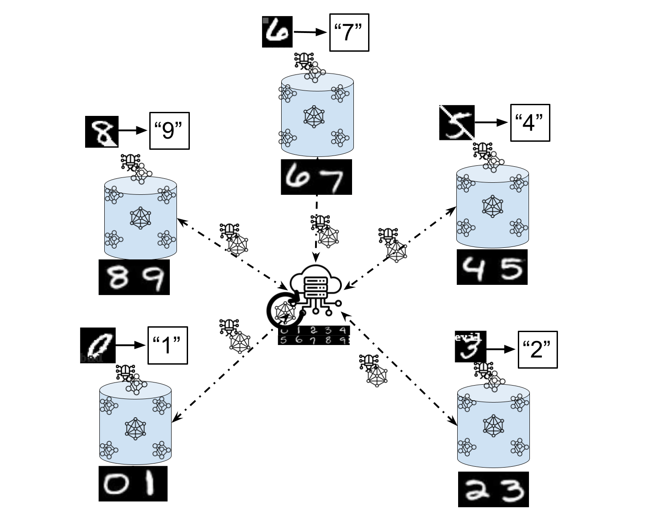
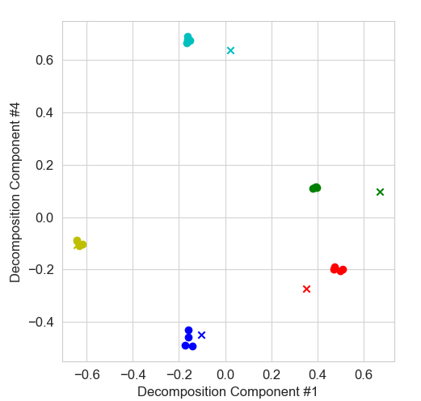
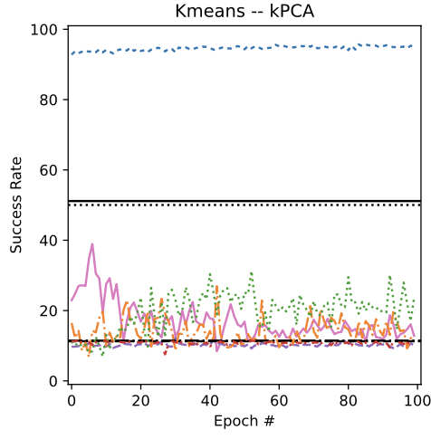
Backdoor Detection in Silo-Based FL Systems
Distribution Detection
Dimensionality Reduction
Anomaly Detection
Robust Aggregation
Notes:
All overlay (bottom left “bad”)
X malicious, Dot normal

Slide 40
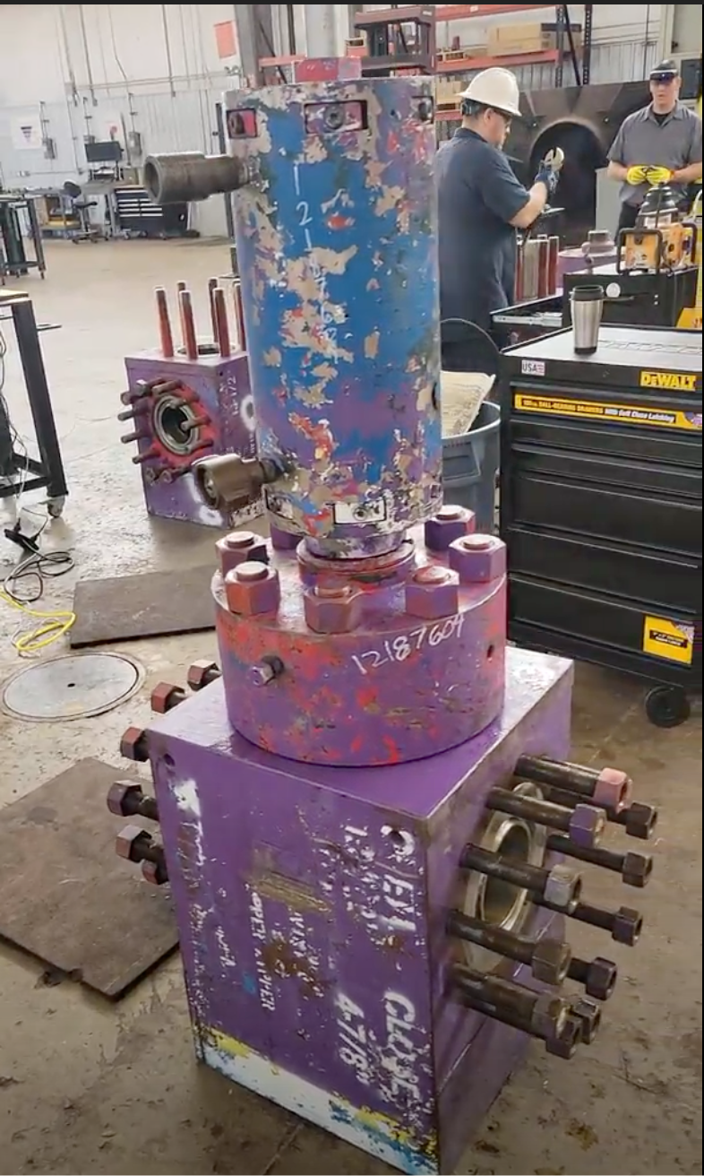
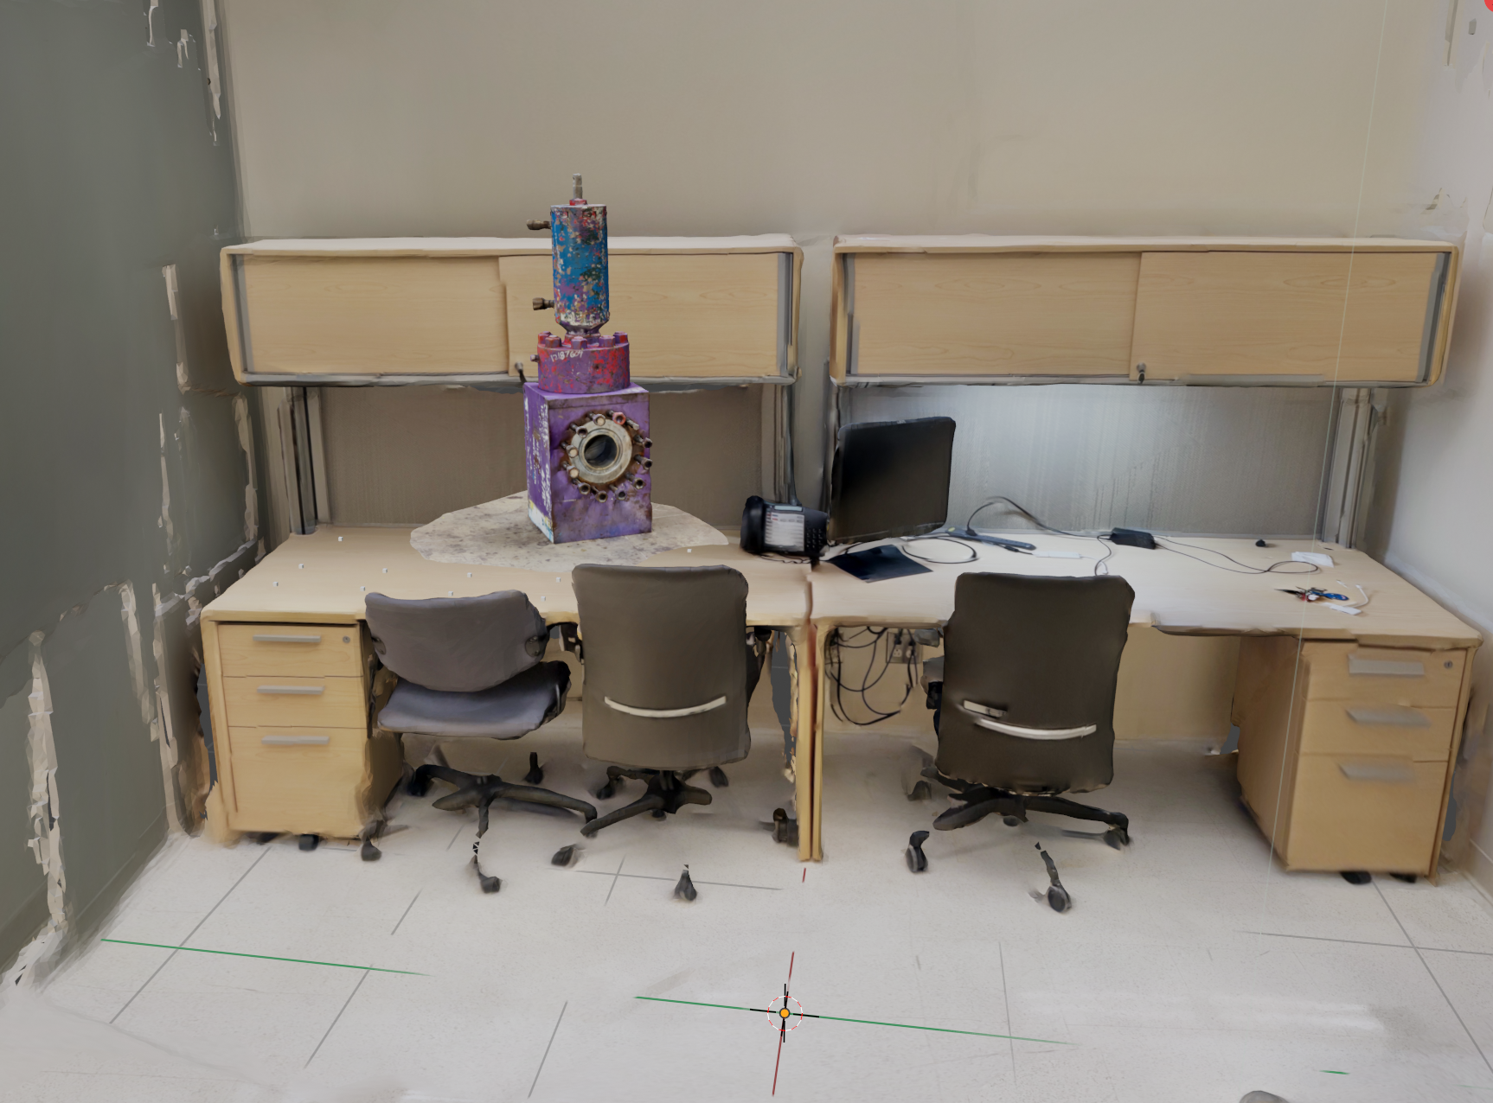
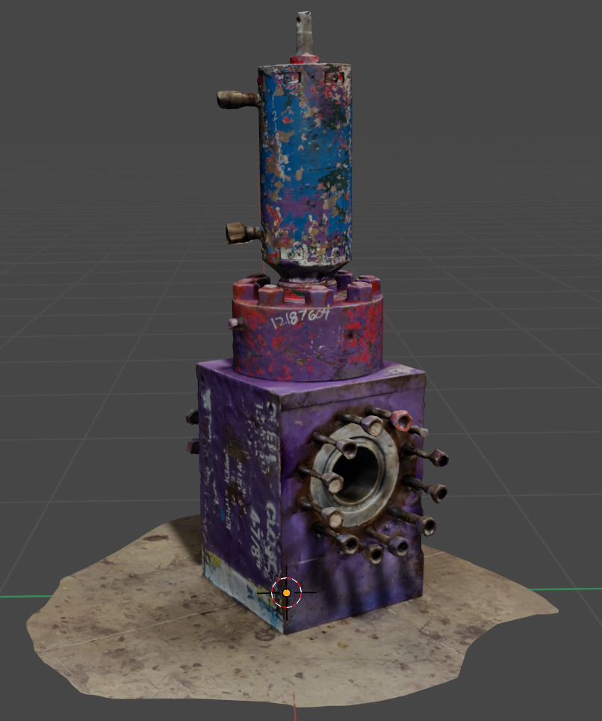
Feedback Loop of Industrial Digital Twins and Synthetic Data Generation
Augment digital twin with real-world conditions (haze, dust, smoke);
and train AI model
Synthetic Data Generation
Fine-tuning on
Real-World Data
Annotate /
Synthesize
Process Capture
Location-Specific
Deploy
Project design process into virtual world
Part-in-Process Detection (LIVE)
Engineering Design
Manual Solutions
(STL, CAD, OBJ)
React to real-world
performance in design
Notes:
Start bottom right
initially, you have a CAD design of some sort. 3D scan it, now you have a model
Up “process capture” : in location scanning. For us: small indoor locations
Top right: synthetic data generation. Photorealistic scenarios including the generated model onto odd places
Also other type of augmentations like overlay of haze etc. Generates millions of scenes without annotation
Fine tune mixing real word and synthetic data for training
Deploy in production. For us: hololens detect the objects in the environment
Closing the loop: if errors are detected, it can be feed back to the engineering team to lessen the likehood of the problem occurring

Slide 41
Supporting Architecture for Real-World Deployment
Notes:
The new (and allegedly insecure) devices aren’t and shouldn't be added to the corporate network so the architecture splits this. The edge network talks to the clouds and does the new computation over there, while there is n=limited or no modification to the existing corporate network. In our case, our partners were using office & pdf documents, so we made sure that our middleware (hololens) can read these

Slide 42

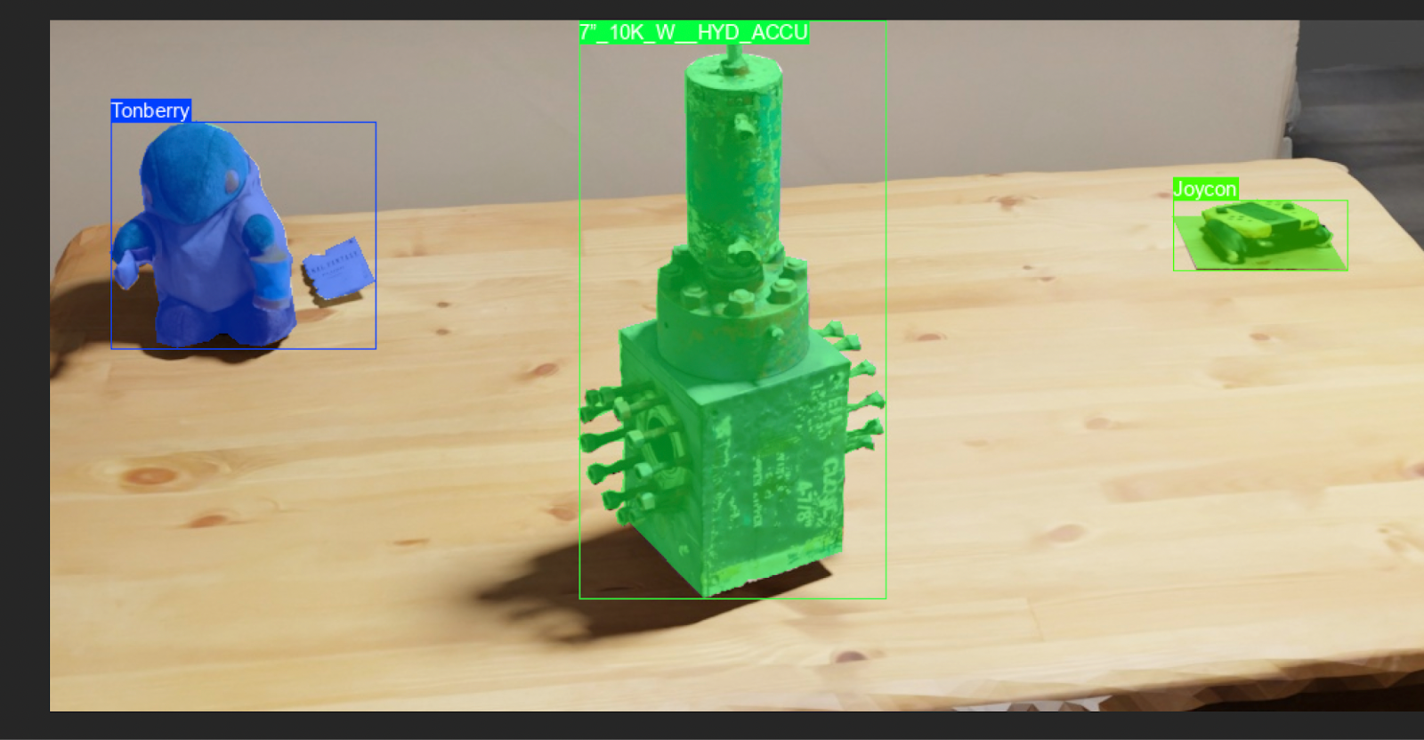
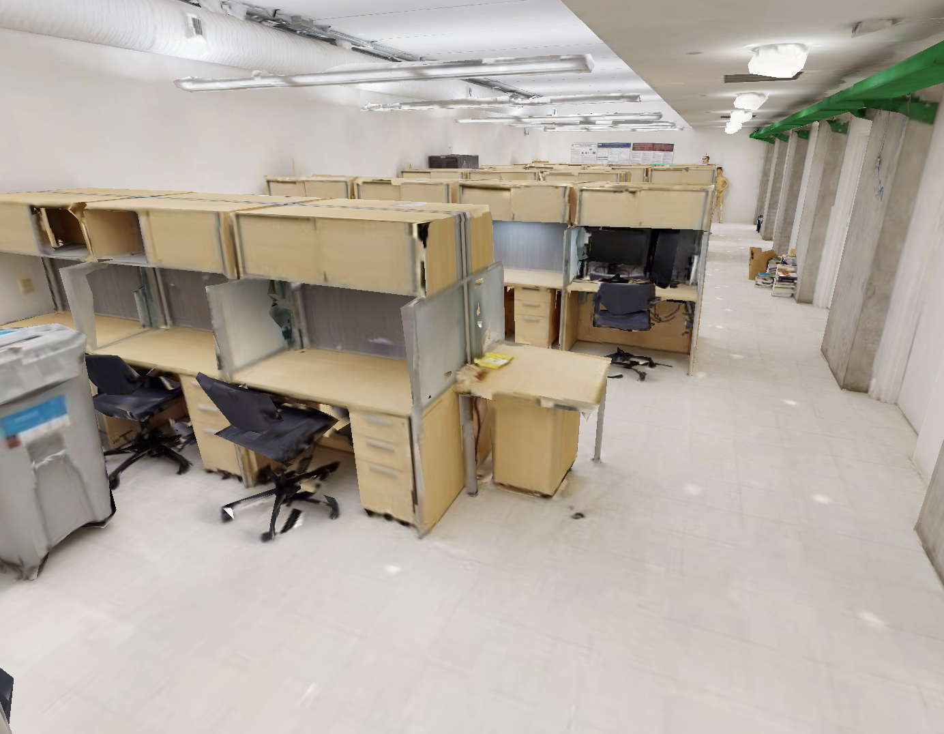
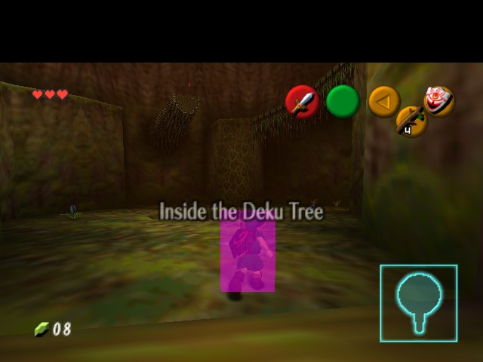
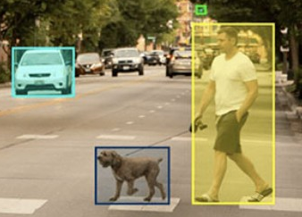
A Metaverse of Digital (Evil) Twins
Notes:
Left-to-Right
Purely synthetic data (video game environments).
Synthetic data of 3D scans in unrealistic environments (realistic-looking but possible only in simulated environments).
Real-world objects in realistic-looking environments (real objects in real-looking scenes – but scenes aren’t real) – yields ”limitless” real-like data.
Real-world scenes converted into digital twin environments.
Real-world data.
All are capable of dataset poisoning. The sheer scale makes manual inspection for backdoors even less possible.

Slide 43
The “BITCOIN GENERATOR” scam detection and analysis
Badawi, E., Jourdan, G.-V., Bochmann, G. v. and Onut, I.V. Automatic Detection and Analysis of the Bitcoin Generator Scam, in Proceedings of 4th IEEE Security & Privacy on the Blockchain, virtual event, September 2020.

Slide 44
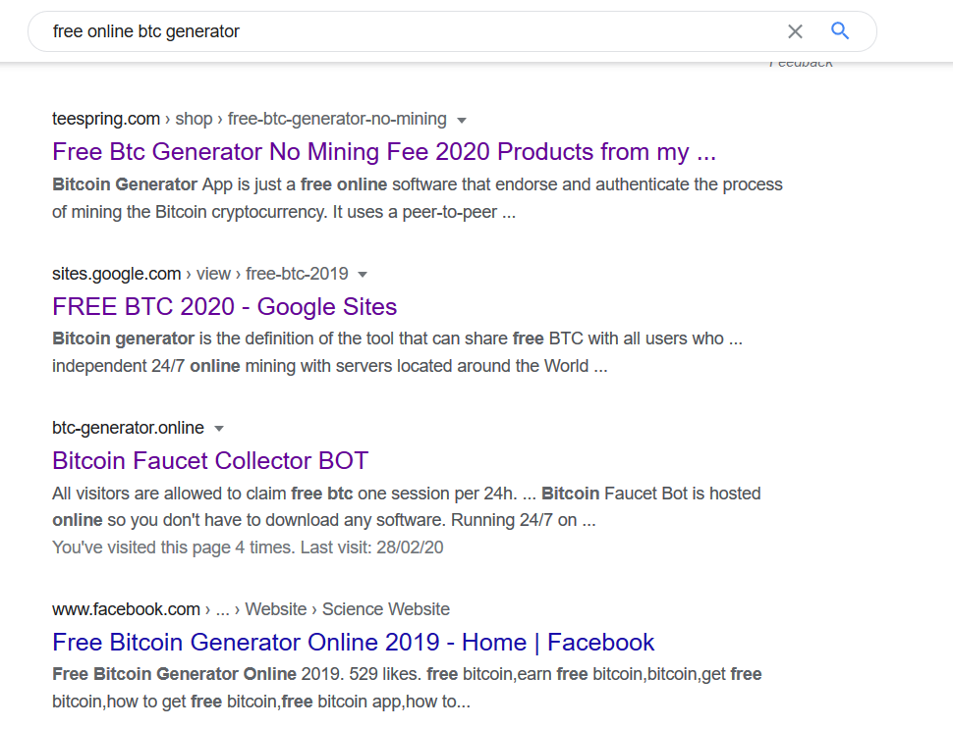
The “BITCOIN GENERATOR” scam detection and analysis
Leads to scam
Leads to scam
Scam
Leads to scam

Slide 45
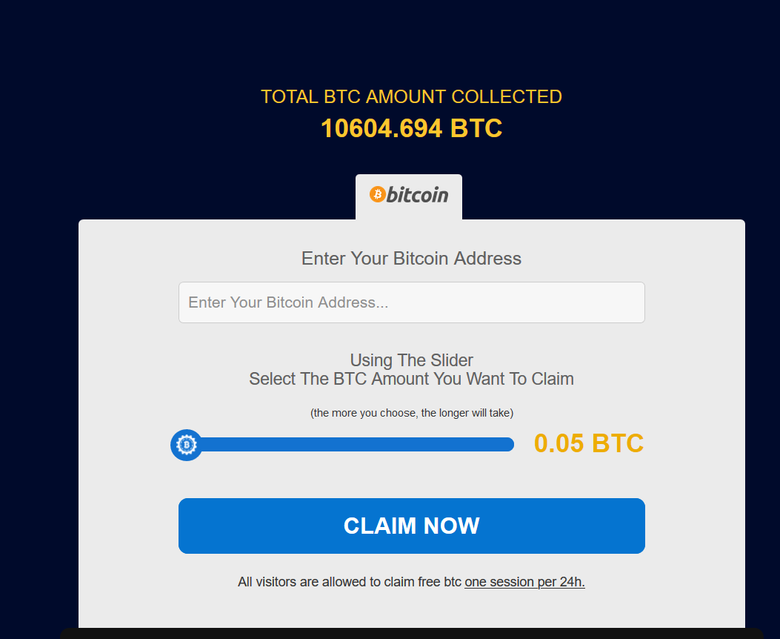
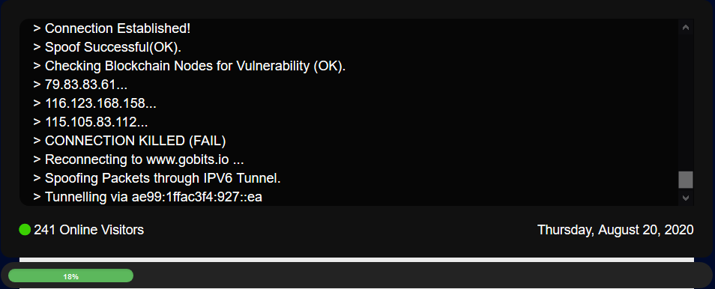
The “BITCOIN GENERATOR” scam detection and analysis

Slide 46
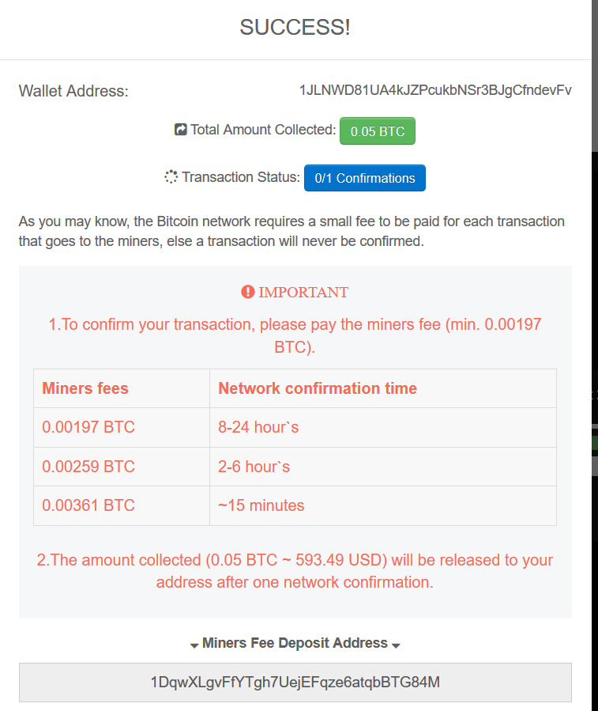
The “BITCOIN GENERATOR” scam detection and analysis
The victim is asked to pay a
"mining fee” to collect the funds

Slide 47

The “BITCOIN GENERATOR” scam detection and analysis
Built the queries using:
The contents of the ``Keywords'' meta tag from the BGS instances.
Google's automatic ``related search'' suggestions.
Created 696 queries, searched daily on Google, Yahoo, Bing.

Slide 48
The “BITCOIN GENERATOR” scam detection and analysis
10-fold cross-validation on 330 clean pages and 330 BGS pages.
Classifier | Page Type | Classified Clean | Classified BGS | F1
Support Vector Classifier (SVC) | Clean | 327 | 3 | 98.92
 | Generator | 4 | 326
Multi-layer Perceptron (MLP) | Clean | 327 | 3 | 98.92
 | Generator | 4 | 326
Random Forest (RF) | Clean | 329 | 1 | 95.9
 | Generator | 25 | 305
Naive Bayes (NB) | Clean | 327 | 3 | 96.58
 | Generator | 19 | 311
K-nearest neighbors (KNN) | Clean | 319 | 11 | 97.9
 | Generator | 3 | 327

Slide 49
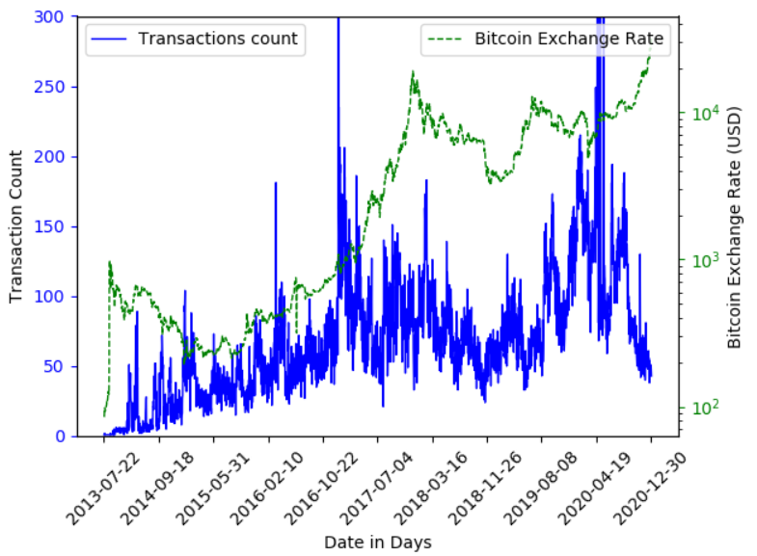
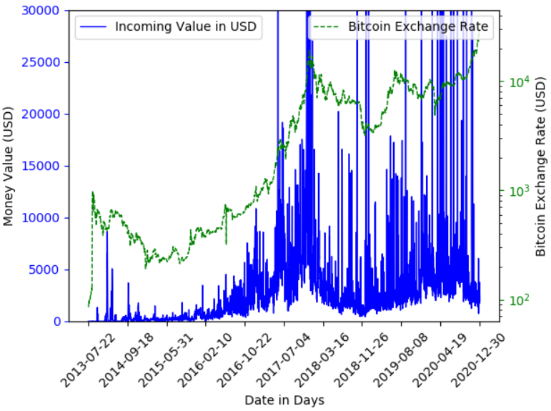
The “BITCOIN GENERATOR” scam detection and analysis
Received 2,908 bitcoins (~9.3M USD) from November 2013 to December 2020.

